Slide 1

3D Visual Effects everywhere
By Fish Run Games
https://fishrungames.com

Slide 2

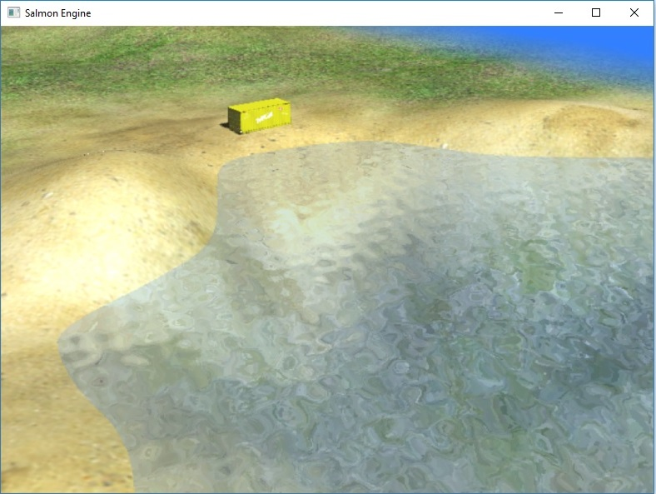
We specialize in
Virtual reality
Computer vision
Augmented Reality
3D Graphics rendering
Game Development

Slide 3
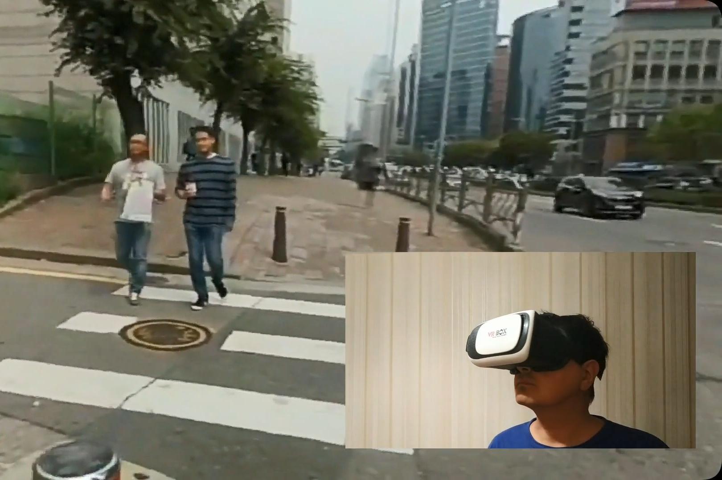
Virtual reality
We develop VR applications since 2018. We have our own 3D Rendering engine based on OpenGL capable of rendering VR environment even on a regular devices. No special VR devices needed.

Slide 4
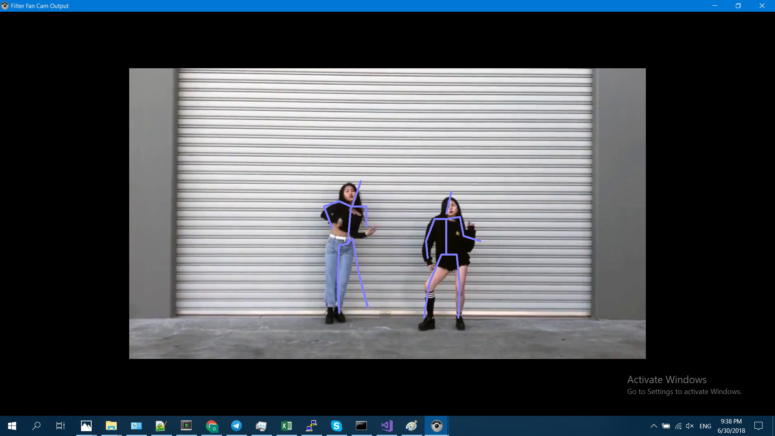
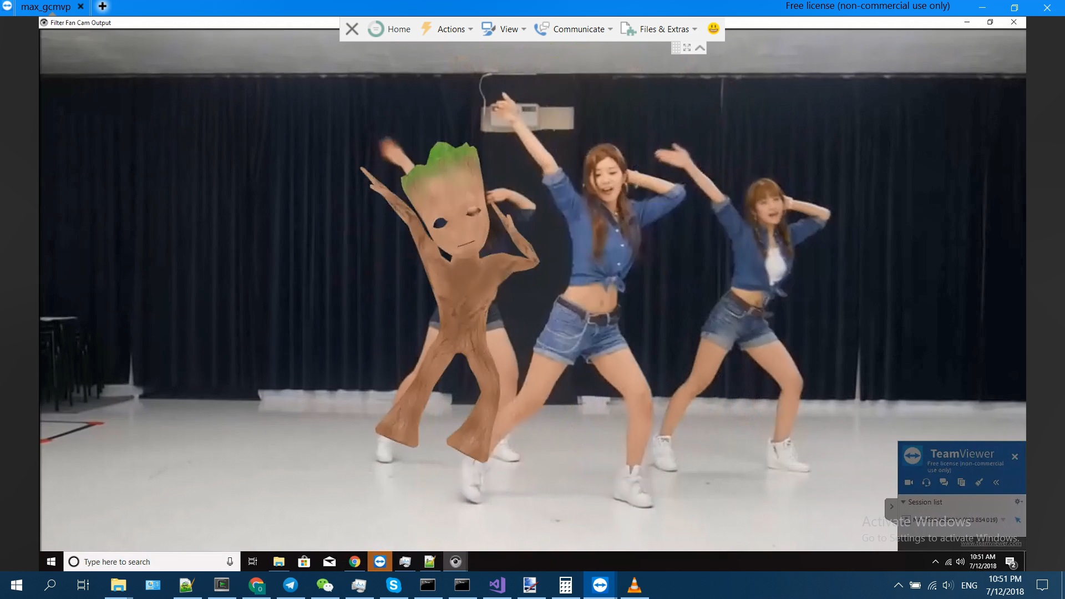
Computer vision
We use OpenCV and modern machine learning frameworks, such as TensorFlow and Caffe, to perform object recognition from photos and videos. Our solutions are available both for Web, Mobile and Desktop.

Slide 5

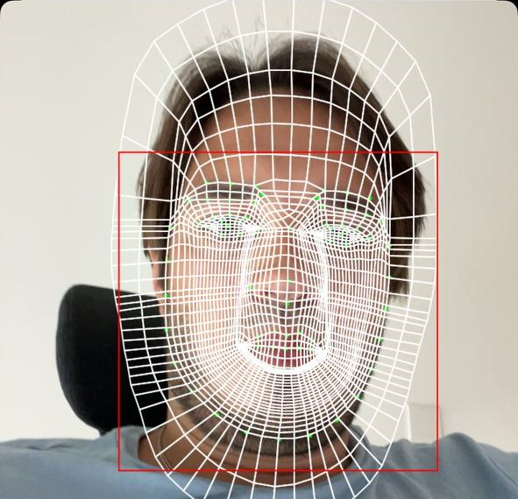
Augmented Reality
We use our own 3D Rendering engine to render 2D or 3D objects over video stream, providing high quality AR experience.

Slide 6

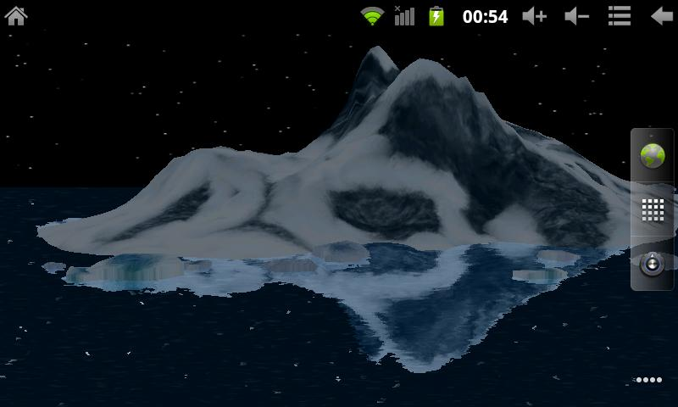
3D Graphics rendering
We can render modern 3D graphics everywhere – not only on Desktop or Mobile, but also in your web browser.

Slide 7
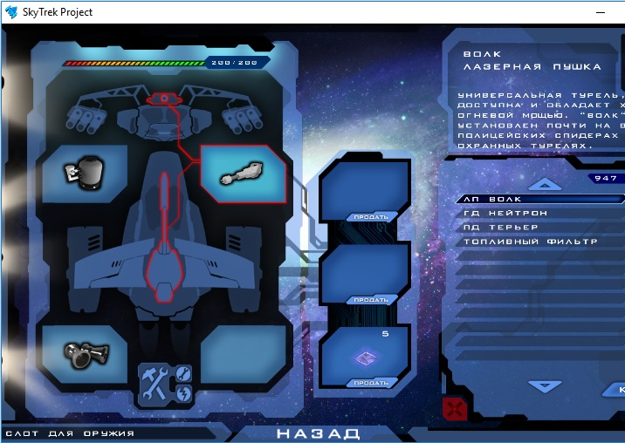
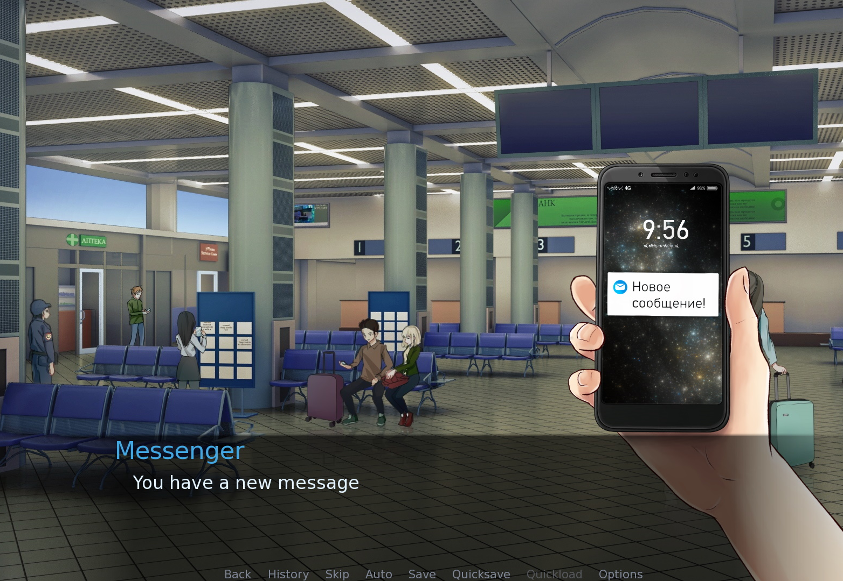
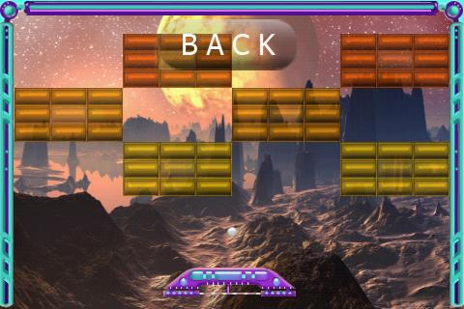
Game Development
We develop games since 2012. We can provide game development service, using variety of engines: Cocos2D, RenPy or bare OpenGL/Metal.

Slide 8
Interested?
Email me: mephi1984@gmail.com
Our website: https://fishrungames.com
Our portfolio: https://fishrungames.com/portfolio.html
Telegram: @mephi1984
Phone: +996 773 610568

Slide 9

Thank you!

